Slide 1
Evaluating the Inclusiveness of our Municipal Government
Date
Notes:
Note to Presenter:
Purpose of template
This presentation is a Template that you can customize and use to:
Communicate the benefits of evaluating your municipal government’s inclusiveness in terms of policies and practices as an employer and service provider
Educate municipal staff, elected officials, and stakeholders on how you will conduct an evaluation using AUMA’s Measuring Inclusion Tool for Municipal Governments.
Provide instructions on their role.
Who does this template benefit?
The Template is useful to municipalities that have already committed to inclusion work and are ready to evaluate their efforts to-date or those just starting out.
Can I edit the template?
The template can be used as is, or modified to suit your objectives for the presentation, your audience and your specific context.
Length of presentation
This presentation will take 10 - 20 minutes, depending on the level of detail appropriate for the audience.

Slide 2
Agenda
Defining diversity and inclusion
The benefits of inclusion
Why measure the inclusiveness of our organization
Overview of AUMA’s Measuring Inclusion Tool for Municipal Governments
Instructions

Slide 3
What is diversity and inclusion?
Diversity is any dimension that can be used to differentiate people from one another.
Inclusion is the act of creating environments in which any individual or group can feel welcomed, respected, supported and valued to fully participate.
Diversity is being invited to the party.
Inclusion is being invited to dance at the party.
Notes:
To start this conversation, we want to make sure everyone understands what we mean by the terms diversity and inclusion.
Diversity is any dimension that can be used to differentiate people from one another.
Common dimensions used in our society include gender, age, ethnicity, skin colour, sexual orientation, religion, level of income or education, or physical or mental ability.
Inclusion is defined as creating environments where any individual or group of people can feel welcomed, respected, and valued to participate without fear of exclusion or discrimination.
A simple way to look at this is to picture a scenario where we invite everyone in our community to a big party and everyone shows up.
That party is then full of diverse groups of people, but it doesn’t necessarily mean it is inclusive.
It is inclusive when everyone in that party is invited to dance together and everyone feels safe doing so.

Slide 4
What is an inclusive community?
A community where people of every age, gender identity, sexual orientation, ethno-cultural identity, race, physical and mental ability, income and educational level, and religion feel included, valued, and empowered.
Or in other words:
A community where everyone can feel safe, whomever we are, or wherever we come from, no matter how we look, how we worship, how much money we have, or who we love.
Notes:
An inclusive community is really the same.
It is a community where everyone feels a sense of belonging and has the opportunity to reach their full potential because they don’t experience barriers or feel excluded.

Slide 5
Why our municipal government should support inclusion
We have a mandate to serve all residents – Everyone should have equitable access to our services
Reduce social conflict
Encourage business growth and attraction
Involving more people leads to new innovation
Remove barriers so all employees and residents can reach their full potential
Notes:
There are numerous reasons why our municipality is focused on being inclusive.
One of the most important reasons is that we have a mandate to serve all residents.
The key word being ‘all’ residents.
We should be striving to ensure that our services are accessible to all residents and that there are equitable outcomes for all users.
The benefits of creating an inclusive organization and community include:
Reducing social conflict;
Supporting businesses to grow and develop in our community;
New and innovative ideas because we are attracting diverse groups of people to work for the municipality as well as come to the table when we consult residents; and
Creating a workplace and community where people want to stay and attract others to our community to come live an enriching life.

Slide 6
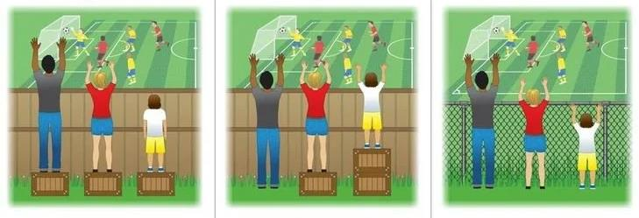
Equality
Equity
The goal
The assumption that everyone benefits when people are treated equally.
Everyone gets the supports they need to participate, thus producing equity.
Everyone can participate without supports or accommodations because the cause of the inequity was addressed. The barrier was removed.
Notes:
As I mentioned, we want to create equitable outcomes for all residents and users.
It is important to discuss what we mean by equity as it can often be confused with equality.
Equality is when all persons are treated equally.
For example, in the left image, everyone is treated equally and the outcome is that the shorter person can not see the game.
Equity is when steps are taken to ensure everyone can actively participate.
The centre image shows how the boxes have been rearranged so that all persons can see the game.
But our ultimate goal is remove all systemic barriers so everyone can participate without supports or accommodations.
Sometimes it is hard to see these barriers unless we experience them ourselves or we see a friend or family member experience the barrier.
This is why inclusion work is so important so we can become more aware of how our policies or practices may be excluding certain people from participating.

Slide 7
Why evaluate our work on inclusion
To assess the progress of inclusion work in our municipality
To be able to communicate our progress to management, council, our community partners and other stakeholders
To create a case for allocating resources to inclusion work
To provide a framework which can be used to work with community partners to achieve common goals
Notes:
Evaluating our inclusiveness is beneficial as it will highlight gaps and can help convince others to take action once the issue is brought to everyone’s attention.
The results of the evaluation and a plan of action will also provide us with a framework with which to move ahead and will help to justify the allocation of resources.
Evaluating our progress will help us understand the change process required to becoming a more welcoming and inclusive community.

Slide 8
Introduction to AUMA’s Measuring Inclusion Tool for Municipal Governments
Fall 2019
Notes:
One way to evaluate our inclusiveness is to use a tool called the Measuring Municipal Inclusion Tool for Municipal Governments, which is offered by AUMA.
Over the next few slides, I will provide an overview of this Tool.

Slide 9
Who is AUMA
The Alberta Urban Municipalities Association (AUMA) represents Alberta’s urban municipalities − including cities, towns, villages, summer villages, and specialized municipalities.
Advocates on behalf of urban municipalities and also delivers numerous business services to support municipal needs.
AUMA’s Welcoming and Inclusive Communities (WIC) initiative offers tools and resources to overcome issues of social exclusion.
Notes:
If you aren’t familiar with AUMA, it is the Alberta Urban Municipalities Association.
AUMA was established in 1905 and represents over 260 of Alberta’s cities, towns, villages, summer villages and specialized municipalities, representing over 85 per cent of Albertans.
It acts as a single voice to advocate to other levels of governments and stakeholders for programs and legislation that will allow urban municipalities to thrive.
Through this role, AUMA also creates tools and resources to support the needs of municipalities.
One of which is their Welcoming and Inclusive Communities initiative, which offers tools and resources to help municipal governments to implement policies and practices to overcome issues of social exclusion in Alberta’s communities.
[IF APPLICABLE]
Our municipality is a member of AUMA and we also take advantage of AUMA’s line of business services including _________________________________ [insert services used locally such as insurance, benefits, energy programs, purchasing program, or other programs]

Slide 10
Overview of the Measuring Inclusion Tool
Assists a municipal government to:
Assess its current state of inclusiveness.
Identify areas for improvement.
Advance strategies to be more inclusive of employees, residents, and service users.
Provides a framework to measure ongoing performance.
Notes:
AUMA’s Measuring Inclusion Tool offers a framework for us to assess how inclusive we are as an employer, service provider, and leader in our community.
It will help us to understand the areas in which we have created a culture of inclusion and the areas where we can make some improvements.
More importantly, it gives us a benchmark of our current state of inclusiveness so we can make plans to improve over time.

Slide 11
Areas of Focus
Leadership
Municipal Social Services
Commitment of Resources
Planning, Implementation & Measurement
Human Resource Policies & Practices
Employee Engagement & Education
Infrastructure & Land Use
Resident Engagement
Economic Development
Emergency & Protective Services
Transit Services
Housing
Notes:
The Tool is broken down into 12 areas of focus.
As you can see, the Tool covers the key areas of operations of most municipal governments.
[If your audience or organization is only evaluating a limited number of the areas]
Our organization is going to be focusing on the areas of: ______________________________.
In terms of your role in the organization, we are asking you to evaluate the areas of: ______________________________.

Slide 12
Levels of inclusion
Invisible
We do not recognize that there is a problem.
Awareness
We know there is a problem, we are taking tentative steps, but we are not sure how to proceed.
Intentional Inclusion
We are taking formal steps to eliminate all forms of discrimination through systematic change.
Culture of Inclusion
Inclusion is normal and part of our culture.
Notes:
NOTE TO PRESENTER: A complete definition of each level of inclusion is available in the Measuring Inclusion Tool.
The tool is based on four Levels of Inclusion.
The Levels map out the progression that a municipality might go through in becoming more welcoming and inclusive.
For instance, the Invisible level is when an organization doesn’t necessarily realize there is a problem and its policies and practices might be excluding people.
At the Awareness level, the organization realizes there is improvements to be made, but it hasn’t taken any meaningful steps yet.
At the level of Intentional Inclusion, the organization is taking strategic steps to improve policies and practices to eliminate forms of exclusion and discrimination.
And lastly, the goal is to reach a Culture of Inclusion where all employees and residents are valued and are treated equitably through the services of the municipality.
The municipality will likely find that it is at a different level of inclusiveness depending on the area of focus.
For instance, a municipal government may be demonstrating a culture of inclusion in terms of employee engagement, but may only be at the awareness phase when it comes to its own economic development work.
That is one reason why it is useful for us to evaluate each Area of Focus separately.

Slide 13
Area of focus and description
Levels of inclusion
Topics
Indicators for each topic
Scoring system
Rating scale
Notes:
Here is an overview of what an assessment of an area of focus looks like.
At the top, it shows the title of the area of focus and provides a general description.
In this example, the area of focus is Leadership.
Each area of focus is broken down into five topics.
For example, in the Leadership area, the topics are:
Leadership by elected officials;
Communication by elected officials;
Representation on municipal committees;
Leadership by management; and
How the organization responds to complaints of discrimination.
Each topic is described using four indicators.
The indicators describe situations or characteristics that describe the topic across various levels of inclusion.
At the bottom of the page is the scoring system and rating scale.

Slide 14
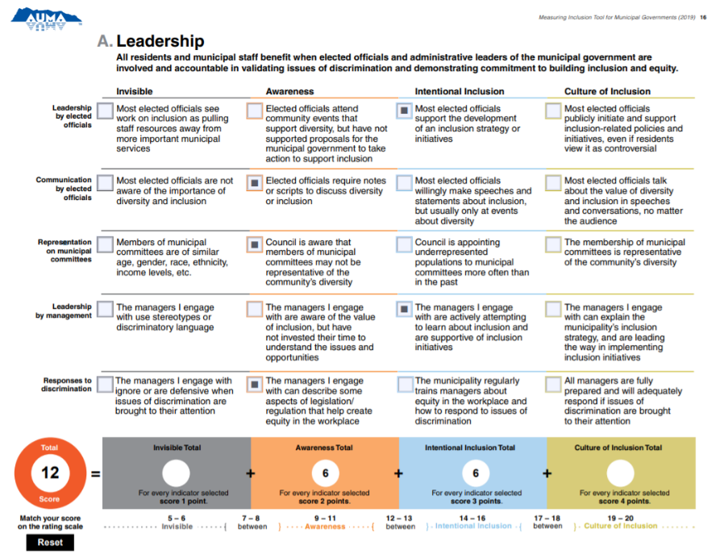
Example
This person’s responses resulted in a score of 12 for this area of focus. This means the person rated the municipality’s leadership at “Between Awareness and Intentional Inclusion”.
Notes:
Here is an example of a completed assessment.
As shown on the screen, the person has selected an indicator under each topic, based on their assessment of the municipality.
Note to Presenter: Use this script if users will complete the Tool using an electronic device where the scores will automatically calculate.
Because we are using the Tool electronically, the Tool will automatically calculate your score but I’ll still explain how the scoring system works.
You can see in this example, the person has selected three indicators in the Awareness column.
Each indicator under Awareness is worth two points so it produces a score of six in the Awareness column.
The person also selected two indicators in the Intentional Inclusion column.
Each indicator under Intentional Inclusion is worth three points each, so it calculates a score of six in the Intentional Inclusion column.
The totals for Invisible and Culture of Inclusion are left blank because no indicators were selected in those columns.
The Tool then adds up the totals from each column to come to a total score for the area of focus.
The total score of twelve is shown in the red circle.
The last step is to find where your total score falls on the rating scale.
As you scroll across the bottom, you see that a score of twelve indicates a rating of ‘Between Awareness and Intentional Inclusion’.
So this person has rated the municipality’s inclusiveness in terms of its leadership as being between awareness and intentional inclusion.
Note to Presenter: Use this script if users will complete the Tool on paper and have to add up their score manually.
To add up the score, you take the following steps.
You can see in this example, the person has selected three indicators in the Awareness column.
Each indicator under Awareness is worth two points each.
So three indicators worth two points each adds up to a score of six.
Therefore, the person has written a six under the Awareness column.
Next, the person has selected two indicators under the Intentional Inclusion column.
Each indicator under Intentional Inclusion is worth three points each.
So two indicators worth three points each adds up to a score of six.
Therefore, the person has written a six under the Intentional Inclusion column.
The totals for Invisible and Culture of Inclusion are left blank because no indicators were selected in those columns.
Next, the person adds up the scores from each column to come to a total score for the area of focus.
In this case it adds up to a total score of twelve so they have written ‘twelve’ in the red circle labeled ‘total score’.
The last step is to find where your total score falls on the rating scale.
As you scroll across the bottom, you see that a score of twelve indicates a rating of ‘Between Awareness and Intentional Inclusion’.
So this person has rated the municipality’s inclusiveness in terms of its leadership as being between awareness and intentional inclusion.

Slide 15
Key items to know
Your responses will be anonymous.
Key words are defined in the Terminology section.
You must rate every topic.
You may feel that you don’t know the answer to some topics. This is expected. Your goal is to answer based on your perception of what is happening in the municipal organization.
Notes:
Now that you understand how the tool works, let’s go over some key items to remember.
First, this assessment should be filled out without letting others influence your answers. Your answers should be based on your own perceptions.
Secondly, your answers are anonymous so you can feel free to answer honestly.
Thirdly, if you aren’t familiar with some of the words used in the tool, you can find definitions of key terms in the ‘Terminology’ section [Explain how they can access this information]
Lastly, you may find some parts of this exercise uncomfortable because you feel you don’t know the answer.
This is expected.
Even if you feel you don’t know the answer, you must still rate every topic.
You cannot skip any topics because that will result in an error in the score.
While you may feel you don’t know the answer, the intent is that you answer based on your perception of what is happening or would happen in that scenario.
There is no wrong answer because you are answering based on your own personal knowledge and perception.
It is possible that some questions have a right answer, especially when it comes to topics related to specific policies.
However, the benefit of this tool is that if many people answer a specific question wrong, then it highlights that leadership needs to do be a better job of communicating that information to all levels of the organization.
So remember to rate every topic and don’t worry about whether it is right or wrong, just answer based on your personal knowledge and perception.

Slide 16
How will this information be used
Your ratings will be consolidated with the ratings of others to produce an average rating for the municipality.
Those ratings will highlight the areas where the municipality is demonstrating a culture of inclusion and where there are opportunities to improve.
This sets the stage to implement strategies to improve.
Suggested strategies are available at wic.auma.ca.
Notes:
Once you are complete, the coordinator is going to collect all the ratings and consolidate them to produce an average rating for each area of focus for the organization.
This will provide a clear understanding of where the organization is demonstrating a culture of inclusion and where there are opportunities to improve.
These ratings provide a benchmark of our current state of inclusiveness.
This sets the stage for us to make improvements.
At that point we will start to discuss potential strategies and actions to make those improvements.
AUMA offers a free guide called ‘Strategies to Improve Your Inclusiveness’, which offers over 200 ideas on how municipal governments can take action to become more inclusive.

Slide 17
Instructions for paper users
Read the four indicators for a topic and select the indicator that best describes our municipal organization. Repeat this process for all five topics.
Add up your score in each column.
Add up the totals from each column and write the number in the ‘Total Score’ circle
Using your total score, find the corresponding number on the rating scale. This is your rated level of inclusion for the area of focus.
Scoring
1 point for every indicator selected under Invisible.
2 points for every indicator selected under Awareness.
3 points for every indicator selected under Intentional Inclusion.
4 points for every indicator selected under Culture of Inclusion.
Notes:
[If you are only using the electronic version of the Tool, delete this slide and use the next slide titled ‘Instructions for electronic users’]
Now this is where you come in.
You have been provided the Area(s) of Focus of: ________________________________________.
Read the description of the area of focus at the top.
Starting with the first topic, read each of the four indicators and select the one that you think best describes our municipal organization.
Repeat this for all five topics.
Then calculate your score under each column and your total score.
Find your total score on the rating scale and circle it if you like.
Once you are complete, ___________________________ [provide instructions depending on whether the user is completing the evaluation on paper or electronically].

Slide 18
Instructions for electronic users
Read the four indicators for a topic and select the indicator that best describes our municipal organization. Repeat this process for all five topics.
The Tool will automatically calculate your total score.
Using your total score, find the corresponding number on the rating scale. This is your rated level of inclusion for the area of focus.
Notes:
[If you are only using the Tool on paper, delete this slide and use the previous slide titled ‘Instructions for paper users’]
Now this is where you come in.
You have been provided the Area(s) of Focus of: ________________________________________.
Read the description of the area of focus at the top.
Starting with the first topic, read each of the four indicators and select the one that you think best describes our municipal organization.
Repeat this for all five topics.
Note your total score and then find it on the rating scale.
Once you are complete, ___________________________ [provide instructions depending on whether the user is completing the evaluation on paper or electronically].

Slide 19
More information
Access 50+ tools and resources at wic.auma.ca
Videos available at bit.ly/AUMA_YouTube
Subscribe to AUMA’s WIC email list or contact WIC for support at wic@auma.ca
Notes:
To learn more about WIC, you can find numerous resources on AUMA’s website at wic.auma.ca, including past webinars that are on AUMA’s YouTube channel.
You can stay up-to-date on inclusion related funding and events by subscribing to their WIC email list and you can contact AUMA with questions about WIC by emailing wic@auma.ca.

Slide 20
Questions

